Slide 1
“Applied machine learning is basically feature engineering” - Andrew Ng
Notes:
Former chief scientist at baidu
Professor at a standford
Cofounder of coursera
Taught the most widely viewed ML course online and the course was the motivation behind creating coursera
ML algos already made been around for decades or 1800s, its really about the data

Slide 2
“If I explain something or use a term that you don’t understand, please ask.” – Some guy

Slide 3
What is a predictive model?
A function that maps input to output
A representation of the patterns between a response variable and its predictors
See spreadsheet example
Models make estimates and by definition they always have errors
Toy car model example
Notes:
Have to have a general understanding of modelling process to appreciate feature engineering
Pauls inf and cnf are attempts at making a real car rather than a toy car model but doesn’t work perfectly. Sometimes you steer left and it goes right

Slide 4
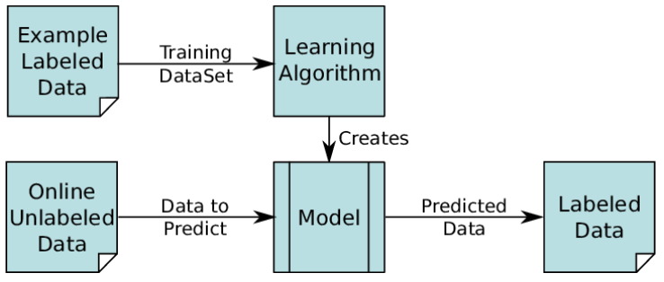
Supervised Machine Learning

Slide 5
Modelling Process
Define problem and goal
Design response variable
Extract raw data
Validate and clean data
Feature engineering
Feature Selection
Algorithm selection
Tune model
Evaluate performance
Repeat steps 2-9 until performance meets goal
Deploy model, monitor results and update
Iterative!
Notes:
Have to have a general understanding of modelling process to appreciate feature engineering
If performance is not good enough it most likely means the data is not good enough
Need representative sample to evaluate performance accurately

Slide 6
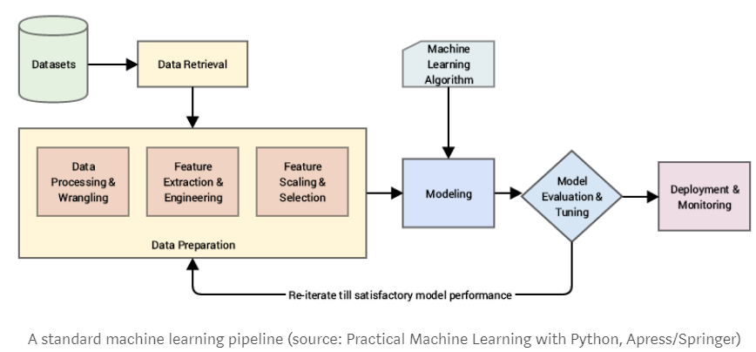
Notes:
DS and everything related to it is not well defined
Ask 10 people what data science is and you get 15 different answers

Slide 7
Design of Response Variable
Response variable is what you are predicting
Should be precisely and consistently defined
More useful predictions are more difficult to predict accurately
Filing requirement vs tax liability
Stock trading strategy example
10% yearly gain vs 50% yearly gain
Notes:
Tax liablity you have to consider exemptions, credits

Slide 8
Validating and Cleaning Data
Apply 80/20 rule and return to it if model performance is affected
Review logic of the code that generated the data
Write code that does the same thing but with simpler logic and compare differences
Review logic of the data itself
Can a TP really have 20+ 1099Int forms from the same payer?
INF cube report says there’s people that filed a return but their estimated return wasn’t reversed off
Take a sample of the data and compare it with some other source
Notes:
You can spend months or a year just cleaning data and it might not even affect performance so it’s best to apply 80/20 rule and return to it
In the end, it’s the results that matter
Remember modelling is an iterative process

Slide 9
Sampling
Validating data by checking a sample of it can provide misleading results
What is the probability of finding at least 1 bad observations given the following parameters?
Total observations = 100,000
Bad observations = 500
Sample size = 100

Slide 10
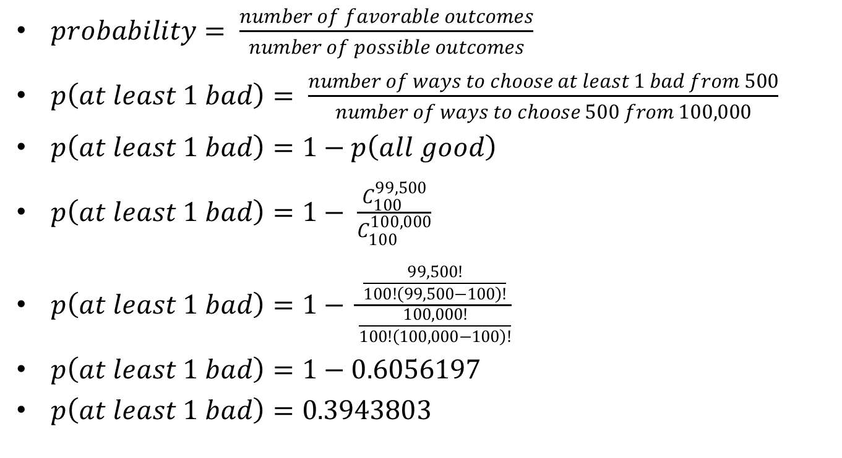
Sampling Question Solution
$probability= \frac{number of favorable outcomes}{number of possible outcomes}$
$p\left(at least 1 bad\right)= \frac{number of ways to choose at least 1 bad from 500}{number of ways to choose 500 from 100,000}$
$p\left(at least 1 bad\right)=1−p\left(all good\right)$
$p\left(at least 1 bad\right)=1− \frac{C_{100}^{99,500}}{C_{100}^{100,000}}$
$p\left(at least 1 bad\right)=1− \frac{\frac{99,500!}{100!\left(99,500−100\right)!}}{\frac{100,000!}{100!\left(100,000−100\right)!}}$
$p\left(at least 1 bad\right)=1−0.6056197$
$p\left(at least 1 bad\right)=0.3943803$

Slide 11
Sampling Question Part 2
How many samples should you check to be confident that data is accurate?
See code
“459 samples needed to be 99% sure that the data is at least 99% accurate” (up to 1000 bad)
“2,276 samples needed to be 99% sure that the data is at least 99.8% accurate” (up to 120 bad)

Slide 12
Feature Engineering
Feature is a model predictor or independent variable
Feature engineering asks: what does your response variable depend on and what is the best representation of the data to learn a solution to your problem?
Good features are informed by domain knowledge or exploratory analysis.

Slide 13
Indicator Variables
Isolates key info and makes it more obvious for the ML algo to find the pattern
Amount of ma income VS ma income over $8k
Amount of 1099G prior year refund and filed prior year ma return VS most likely filed out of state return
Driver License status VSDL status active
Notes:
“shouldn’t a good algorithm learn the key information on its own?”
It depends on the amount of data you have and the strength of competing signals. You can help your algorithm “focus” on what’s important by highlighting it beforehand.

Slide 14
Interaction Terms
Addition, subtraction, multiplication or division of variables to highlight their interaction
MA source income estimate (addition of different sources of income)
MA source income estimate / Non MA source income estimate
Notes:
See code
I will have each income form as predictor separately by add the together as well to highlight it for the ML algo

Slide 15
Feature Representation
License renewal date VS renewed during target tax year
Numeric to categorical mappings
Grouping sparse classes
Grouping by payee state (see code)
Dummy variables
DL age missing value example
Impact encoding
Encoding zip code to fewer classes using response variable

Slide 16
Transformations
Apply some mathematical operation to the features to make it easier for the ML algo to work with
Center and scale for linear algos
Helps with numerical stability and convergence
Also may help with unwanted influence from features with a large magnitude
Log, square root, inverse, box cox, yeo Johnson transform
Helps resolve skewness so statistical tests can be used during modelling
May also help with convergence
Principal component analysis and linear discriminant analysis
Transforms a set of predictors to a smaller set that contains the majority of the information in the original set
PCA makes the predictors uncorrelated with each other which may improve performance
Major downside is that you lose interpretability of the model
Ex. Apply PCA to MA income estimate 1 and MA income estimate 2
Spatial sign transform
may improve performance of aglos that are sensitive to outliers (SVM) by making all samples the same distance from the center of a sphere

Slide 17
Error Analysis
Figure out why observations were misclassified by the model and create a feature that can address the error
Cluster misclassified observations and use those clusters as a feature
Also clustering helps you spot the patterns to why it was misclassified

Slide 18
External Data
Joining payee zip code with US census demographic data
Income
Age
Education
Population density
Notes:
City with high median age might tell us that they live in a retirement community and that they’re a snowbird

